Slide 1
Basic details of the team and problem statement
Ministry/organization name/student innovation : Business and super market
Ps code: (SIH1475)
Problem Statement Title: Student Innovation (Robotics And Drones – There is a need to design robots that can solve some of the pressing challenges of India such as handling medical emergencies , search and rescue operations ,smart shopping etc…)
Team Name : ARDUINO HACKERS
Team leader name: Emmadi Divya
Institute Code: c-19615
Institute Name: JB Institute of engineering and technology
Theme Name: Smart trolley and Smart billing

Slide 2


IDEA/APPROACH DETAILS :
The main idea of the model is to give customer a smart shopping experience by providing smart trolley and billing.
Day by day technology is getting improved and we suggest smart trolley and billing approach that sellers can afford.
Another thing is save time and save labour at billing counter.
Smart billing can reduce administrative costs associated with manual billing processes, such as printing and mailing invoices
Smart billing can accelerate payment collection since invocies
can be delivered electronically and customers can make payment
online.
The sustainability impact also depends on how readily customers adopt and utilize smart trolley.

Slide 3
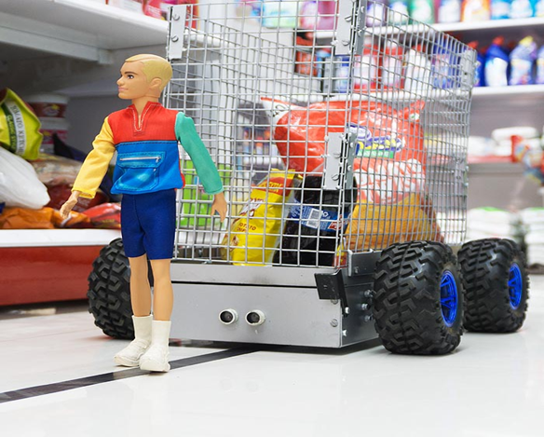

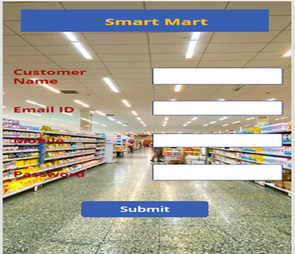
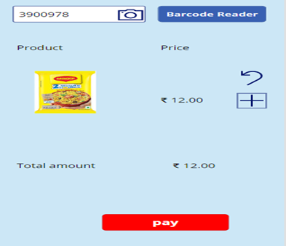
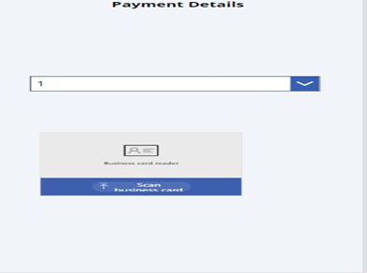
IDEA/APPROACH DETAILS :
ADVANCED TROLLEY SYSTEM :
In the prior only , we need to dump the sketch Map of supermarket so that the trolley knows All the paths of supermarket.
In this system , the trolly is connected to the Mobile via Bluetooth or cloud.so that it follows the Customers and saves the energy of the customers
ADVANCED BILLING SYSTEM :
The billing process is quite easy, it consumes less time and it does not require more employees.
We need to provide the bar code reader in the app that will scan the price of the product and it will allow to add or remove the product from the cart and it will provide the facility to make the payment.
Visualization:

Slide 4
TEAM MEMBER DETAILS:
Team Leader Name: Emmadi divya
Btech – AI&DS-iii year
Team Member-1 Name : Janolla Navanitha
Btech – AI&DS-iii year
Team Member-2 Name :rehaman
Btech – AI&DS-iii year
Team Member-3 Name : Vujjini Deekshitha
Btech – AI&DS-iii year
Team Member-4 Name : ponnala Deekshitha
Btech – AI&DS-iii year
Team Member-5 Name : kodati Vamshi krinshna
Btech – AI&DS-iii year

